Slide 1
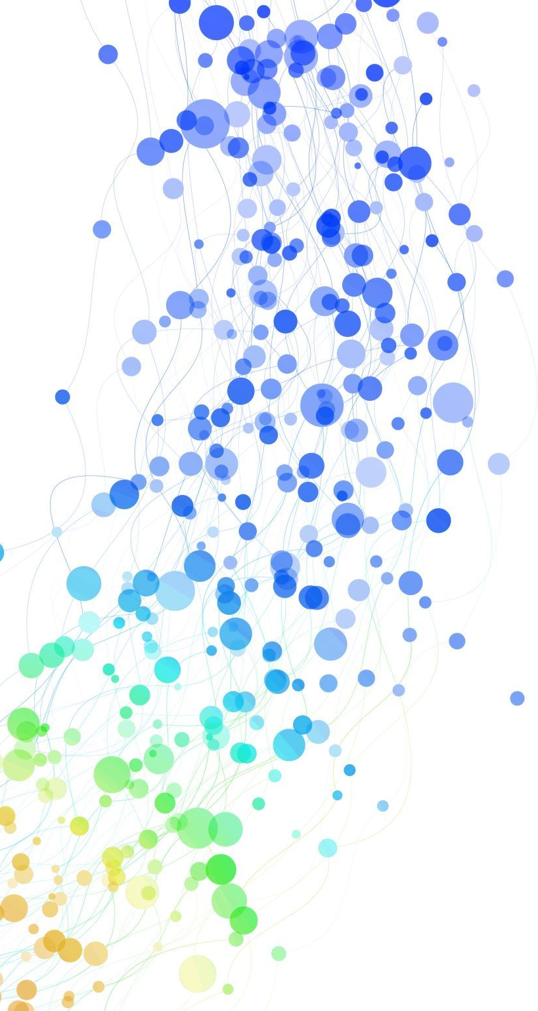
The Robustness of Watermark Embedding Based on Different Transforms with Different Algorithms into Different Frequency

Slide 2
Introduce
identify the source of some image
claim the copyright of it
Notes:
Watermark is usually used to identify the source of some image or claim the copyright of it. In this essay, we are talking about the blind watermark.

Slide 3
Blind---\--->Invisible
the original picture is not necessary for extracting the watermark from the embedded picture.
Notes:
In some unprofessional blogs, the blind watermark is confused with the watermark with good invisibility. However, the blind doesn’t mean invisible
Actually, the so-called blind watermark is referred that

Slide 4
Four Watermark Embedding Method
WATERMARK SORT | TRANSFORM | FREQUENCY | ALGORITHM
Reference | 3-level wavelet transform with Daubechies-8 filters | high | quantized
Low Frequency | 3-level wavelet transform with Daubechies-8 filters | low | quantized
Fourier | Fourier | high | quantized
Additive | 3-level wavelet transform with Daubechies-8 filters | high | additive
Notes:
A kind of method that the blind watermark is embedded into the high-frequency band of the 3-level wavelet transform by quantized algorithm is recommended by an authoritative essay that I referred to. So, I am curious about the different effects if I take different process to the image from what the essay recommends. Then, the recommended method as reference, I began to explore the robustness of similar methods based on it by changing one factor at a time.
In other words, the method that the blind watermark is embedded into low-frequency band of 3-level wavelet transform by quantized algorithm, the method that the blind watermark is embedded into high-frequency band of Fourier transform by quantize algorithm and the method that the blind watermark is embedded into high-frequency band of 3-level wavelet transform by additive algorithm are involved into this report.

Slide 5
Attack
Blurring
Sharpening
Rotate
Cropping
Compress
Salt and Pepper
Notes:
To compare their robustness, the attacks including blurring, sharpening, cropping, rotating, compressing, salt and pepper noise are imposed. The degree of the watermark degeneration will be recorded as according.

Slide 6
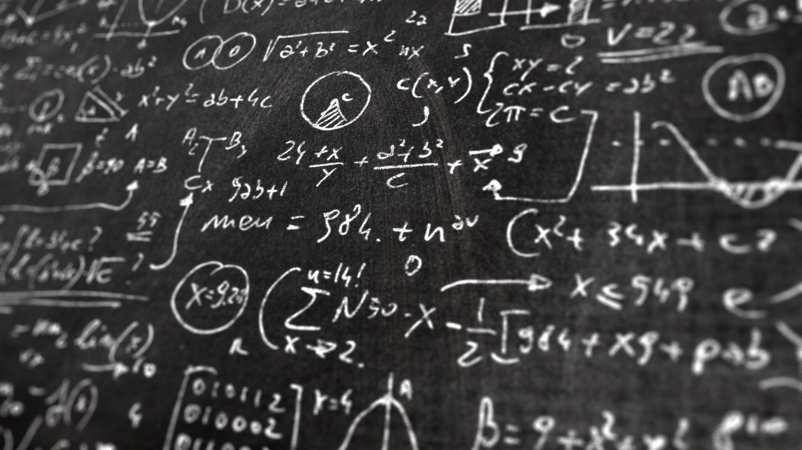
Method
Notes:
Now we mainly focus on how I carry out the exploration

Slide 7
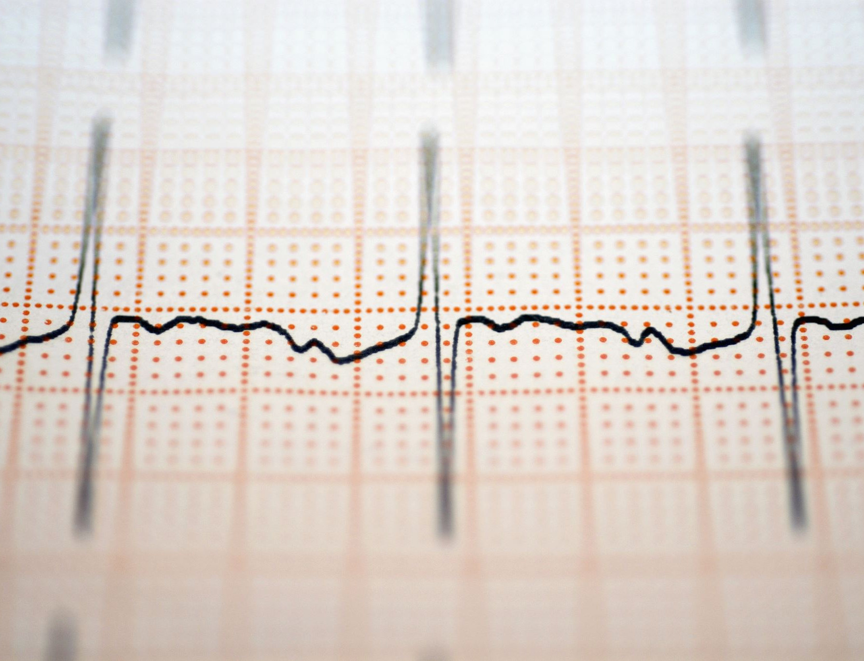
Transform
Wavelet Transform
Fourier Transform
Notes:
There are 2 kinds of transform involved.

Slide 8
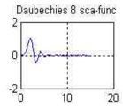
Wavelet Transform
Daubechies-8 filter
3 levels
Notes:
It is widely acknowledged that the obvious advantage the wavelet transform has over Fourier transform is that it contains time information because of using local base as the picture shows. If this is the sin function, it will circulate infinitely. But in the field of watermark embedding. The reason of choosing wavelet transform is that it is able to decompose the available images into sub-bands, in which watermarks can be embedded
And in this report, we use Daubechies-8 filter to proceed 3-level wavelet transform

Slide 9
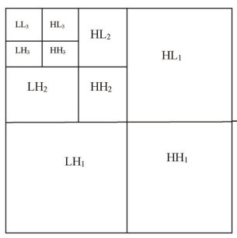
Notes:
After the transform, different frequency components are located as shown. The peripheral parts is the first level transform. diagonal

Slide 10
Fourier Transform
imageAftDft=cv2.dft(np.float32(image), flags = cv2.DFT_REAL_OUTPUT)
The low-frequency band is not shifted to the center, gain the middle square to get the high-frequency band.

Slide 11
Algorithm
Quantized algorithm
Additive algorithm(Dugad’s method)

Slide 12
Quantized algorithm
Embedding
Detection

Slide 13
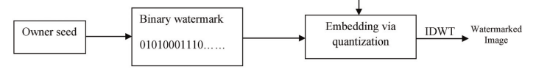
Embedding

Slide 14
Generate wateramark
Boolean
The same size as embedded band
A certain seed

Slide 15
Select satisfied coefficients
higher than t1 and lower than t2
t
0.01< α<0.1 and t2>t1>t

Slide 16
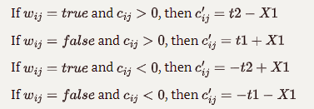
Embedding
Cij: the coefficient satisfying the condition
Wij: the watermark value at the corresponding position
C'ij: the coefficient after quantization
X1: a value narrowing the range between the two quantization
Notes:
the rest can be done in the same manner

Slide 17

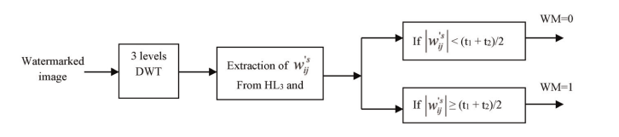
Detection

Slide 18
Select satisfied coefficients
higher than or equal to t1 + X2 and less than or equal to t2 – X2
the value of X2 should be lower than the value of X1
Notes:
This maintains that all the marked coefficients are recovered and dequantized after being attacked.

Slide 19

Extraction
W'ij : the watermark detected at the corresponding position.

Slide 20
comparison
Difflib.SequenceMatcher()
Notes:
the correlation is acquired by using.
But practically, we

Slide 21
Additive algorithm (Dugad’s method)
Embedding
Detection

Slide 22

Embedding
Wij is the coefficient with value higher than t1
Xij is the watermark:
fits the standard normal distribution
a known seed value
equal in size to the input image

Slide 23

Detection
V*i is the coefficient of magnitude greater than t2:
t2 is greater than t1
Wi: the watermark values at the same locations.
N: number of the satisfied coefficients
Notes:
The correlation δ is estimated by correlating the watermark sequence w directly with all N coefficients of the embedded image V*
Usually, a detection threshold τ is established to make the detection decision if δ τ, where only the coefficients above the detection threshold are considered.
But here, we only need to verify the robustness of the watermark instead of ensuring whether the watermark exist or not, so there is no need to set the threshold.

Slide 24
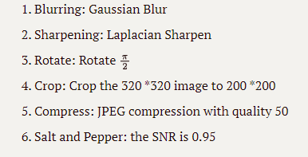
Attacks

Slide 25
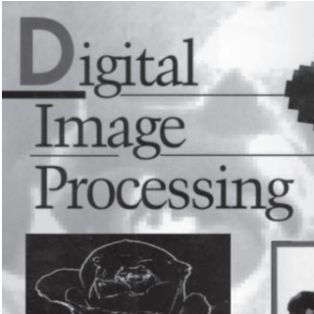
Results

Slide 26
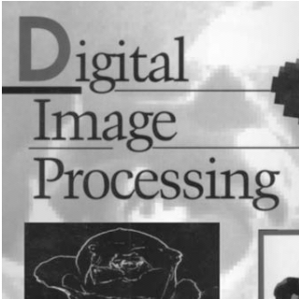



Invisibility
Fourier
Reference
Additive
LowFrequecny

Slide 27

Data
D: the value measuring the degeneration of the watermark
Rbase: the correlation ratio of detecting the watermark instantly after embedding the watermark
Rbefore: the correlation ratio of detecting the watermark before embedding
Rattacki: the correlation ratio of detecting the watermark under attack i

Slide 28
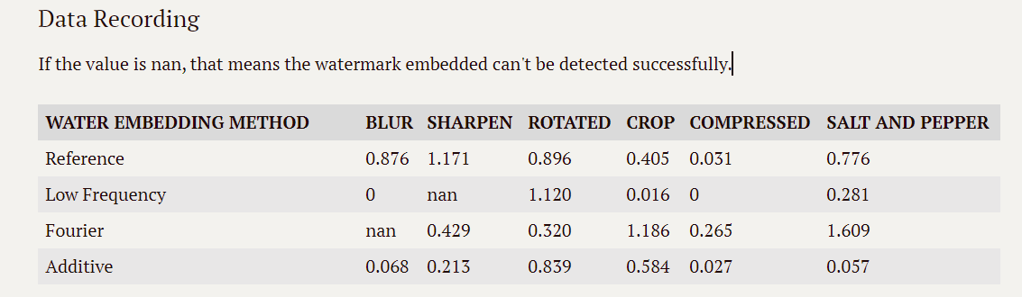
Data Recording
Notes:
Qualitative, quantitative

Slide 29
Discussion
the robustness of Low Frequency and Additive is better than the Reference, especially the Low Frequency
But the watermark embedded in low-pass bands of the wavelet domain affects the fidelity of the watermarked image
the watermark embedded in low-pass bands of the wavelet domain
the watermark in high-pass bands is resistant to another set of attacks such as histogram equalization, intensity adjustment, and gamma correction
it seems that the Fourier transform is more suitable to collocate with the additive algorithm
Notes:
Comparatively speaking, the robustness of *Low Frequency* and *Additive* is better than the *Reference*. Especially, the *Low Frequency*, it is quite robust to the attacks in this experiment. While according to the authoritative essay[^1], the watermark embedded in low-pass bands of the wavelet domain affects the fidelity of the watermarked image and the additive algorithm needs a lot of trails to obtain the most possible watermark serial. Furthermore, the watermark in high-pass bands is resistant to another set of attacks such as histogram equalization, intensity adjustment, and gamma correction which are lack tested here. There is no denying that the experiment is still one-sided. As for the *Fourier*, it seems that the Fourier transform is not suitable to collocate with the quantized algorithm, which is consistent to some popular watermark embedding methods[^3]. They usually use additive algorithm to embed into Fourier high-frequency band.

Slide 30
Reference
Abeer D. Algarni and Hanaa A. Abdallah. Blind Wavelet-Based Image Watermarking
https://zhuanlan.zhihu.com/p/379228103
https://blog.csdn.net/wsp_1138886114/article/details/116780542
https://pywavelets.readthedocs.io/en/latest/ref/index.html
https://github.com/guofei9987/blind_watermark

